Slide 1

ETL Pipeline POC
OLTP to OLAP Data Transformation using AWS Stack

Slide 2
PROBLEM STATEMENT
1. Objective - Transform transactional data into actionable insights for customer analysis.
2. Data Source - A normalized OLTP database populated using the provided PnP.sql script (MySQL).
3. Task
Develop an ETL pipeline to create two denormalized reporting tables within an OLAP data warehouse.
Each table should be optimized to answer a specific business question.
4. Reporting Requirements
Identify the top customers by revenue.
Determine the highest purchaser of glossy paper.
5. Deliverables
Functional ETL pipeline.
Two denormalized reporting tables.
SQL queries that accurately answer the reporting requirements.

Slide 3
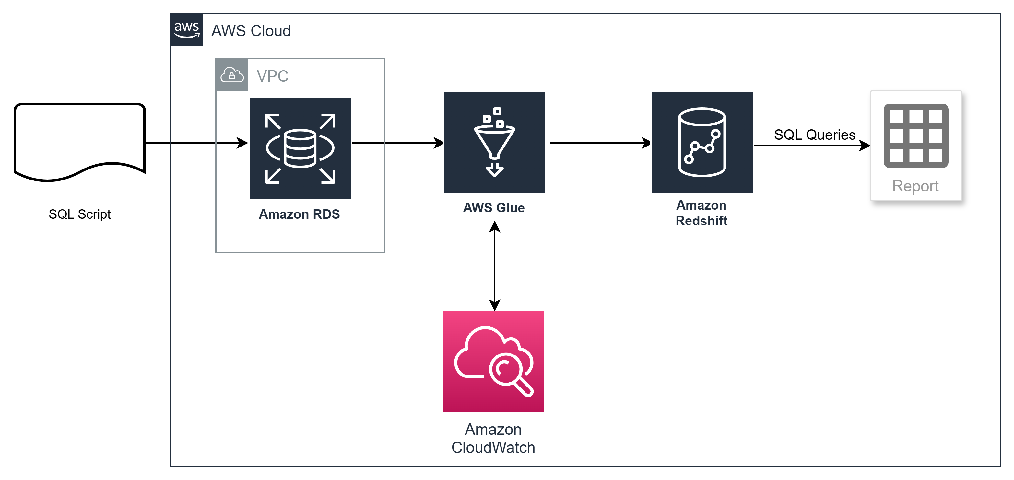
Architecture overview

Slide 4

AWS Components
AWS RDS
AWS Glue
AWS Redshift

Slide 5
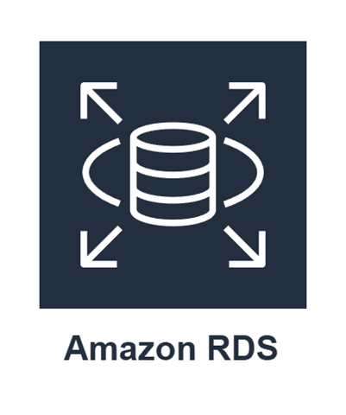
AWS RDS (OLTP Source)
This is a fully managed relational database service designed to handle normalized data within a traditional database format and support high-throughput transactional workloads.
1. Source Setup (Amazon RDS)
Instance Name: database-1
Database Engine: MySQL Community
Database Name: parch_and_posey
Endpoint: database-1.chumqyeg2597.ap-south-1.rds.amazonaws.com
Storage Configuration:
  Allocated Storage: 20 GB
  Storage Type: General Purpose (gp2)
  RAM: 1 GB
  User: admin

Slide 6

AWS GLUE (ETL Service)
This is a serverless data integration service that automatically discovers and profiles data. It generates optimized Spark ETL code, and handles data transformation and denormalization.
1. ETL Setup (Amazon Glue)
Job Name: parch_and_posey
Job Version: Glue 4.0
Job Type: Spark
IAM Name: demo-glue-role
Glue Connection:
  Aurora Connection
  Redshift Connection
# Sample Glue job configuration
job_config = {
  "workers": 10,
  "workerType": "G.2X",
  "timeout": 2880,
  "maxRetries": 0
}

Slide 7

AWS REDSHIFT (olap tARGET)
This is a fast, fully managed, petabyte-scale data warehouse service in the cloud. It's designed for high-performance analytics on large datasets.
1. Destination Setup (Amazon Redshift)
Namespace: sandbox
Workgroup: sandbox-workgroup
Database Name: dev
Endpoint: sandbox-workgroup.575108926287.ap-south-1.redshift-serverless.amazonaws.com:5439/dev
IAM Name: AmazonRedshift-CommandsAccessRole-20250217T101432
Glue Connection: admin

Slide 8
REDSHIFT QUERY
Top Customers by Revenue
    SELECT name, glossy_spending
    FROM glossy_paper_customers
    ORDER BY glossy_spending DESC
    LIMIT 1;
Highest Purchaser of Glossy Paper
    SELECT name, total_revenue
    FROM customer_revenue_report
    ORDER BY total_revenue DESC
    LIMIT 10;

Slide 9
Performance optimization
Key Metrics
ETL Job Duration
Data Processing Rate
Resource Utilization
Query Response Time
Monitoring Dashboard
Job Success Rate
Error Tracking
Resource Consumption
Cost Analysis

Slide 10
SECURITY SCOPE
Data Protection
Encryption at Rest(RDS, Redshift)
Encryption in Transit
VPC Security Group
Access Control
Least Privilege Principle
Role-based Access
Audit Logging

Slide 11
OTHER DETAILS
AWS LINK:-
Console Sign-in URL - https://575108926287.signin.aws.amazon.com/console
Username- leeway_hertz
Password - Tstpass123
GITHUB
URL - yashmj360/ETL(public)
Clone - https://github.com/yashmj360/ETL.git
RDS & REDSHIFT
Username - admin
Password - Tstpass123

Slide 12

Thank You
Yash Vedant
+91 9742144850
yvedant18@outlook.com

